Slide 1

Welcome Everyone
Group Members –
Md. Fazlul Karim 2014182643
K.m. Umar Sayeef. ID: 2012933645
Farin Farjana Sara. ID: 2013528045

Slide 2
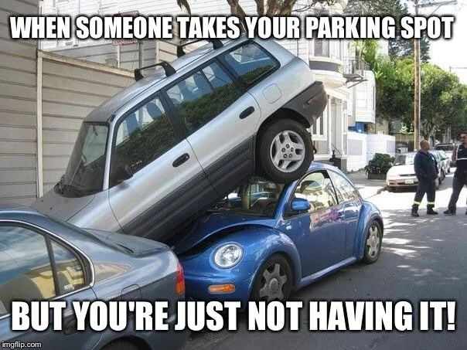
A GREAT PROBLEM

Slide 3
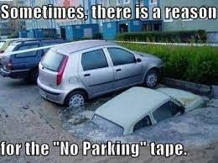
SIMPLE SOLUTION

Slide 4
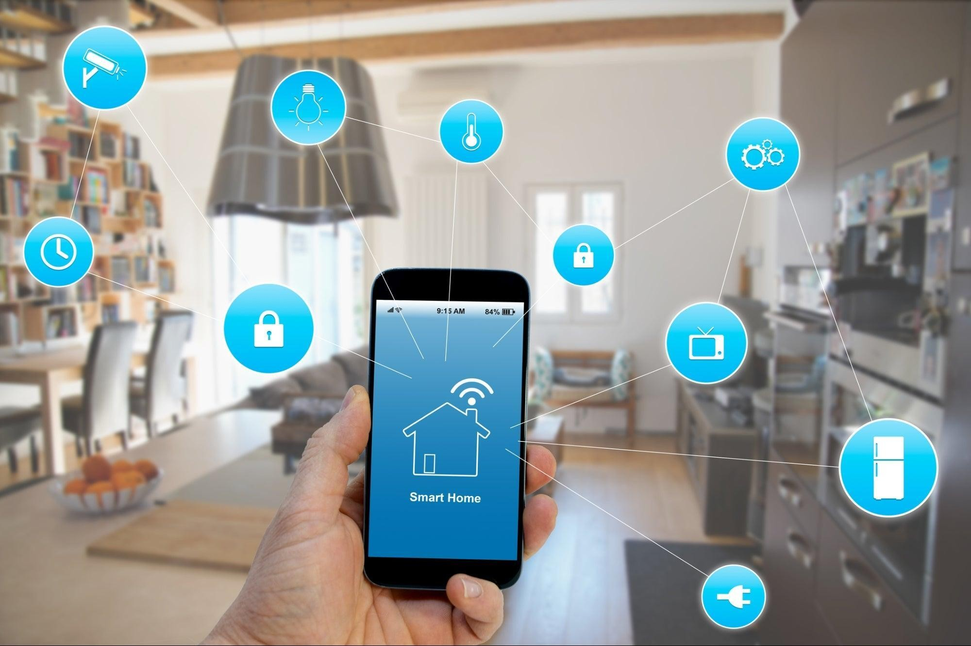

PROJECT NAME
HOME AUTOMATION USING ARTIFICIAL INTELLIGENCE

Slide 5
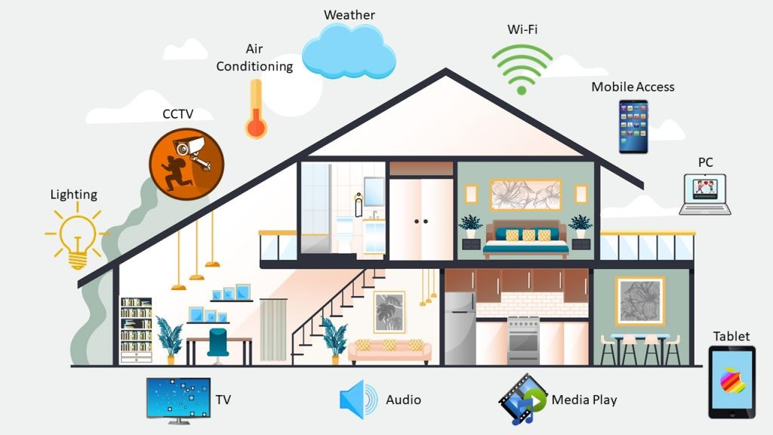
WHAT IS SMART HOME?
Smart homes can choose to have smart speakers, lights, thermostats, doorbells, or home hubs. Smart technology can also extend to kitchen appliances or outdoor or landscaping equipment. New innovations are continually evolving what is in a smart home.

Slide 6
WHY SMART HOME?
Provides convenience and comfort to the homeowners
Save energy and reduce utility bills
Enhance home security

Slide 7
PROJECT SEGMENT
There are three major parts in this project –
Smart Door
Virtual Assistant
Smart Car Parking System
1
2
3

Slide 8
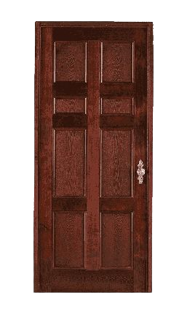

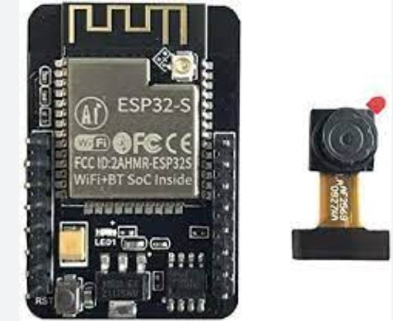
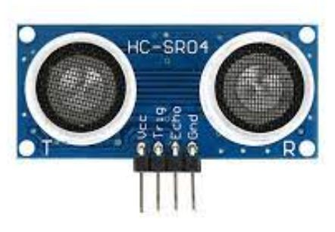


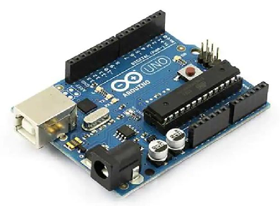

1. SMART DOOR
ESP32 Camera Module

Slide 9





2. VIRTUAL ASSISTANT
Request
Response
“Hello”
“Hey! How can I Help you?”

Slide 10





3. SMART CAR PARKING SYSTEM
Image Classification
Server

Slide 11
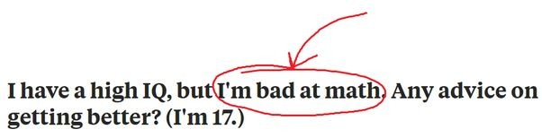
SMART, BUT FLAWED

Slide 12
DRAWBACKS
1. Smart Home
Servo motor rotation angle not exact
2. Virtual Assistant
2. Parking System
Capturing noise while receiving voice
Camera resolution too poor Opencv accuracy 95%
Using ESP32, accuracy is only 10%

Slide 13

Fazlul
Saif
Farin

